Slide 1
Weekly Review

Slide 2
Duolingo
Logan Danner – 75 Days

Slide 3
This week / Loose Ends
DocPac will be printed later in the week to ensure accuracy
Anything you need to write in the docpac, write in a notebook or text file

Slide 4
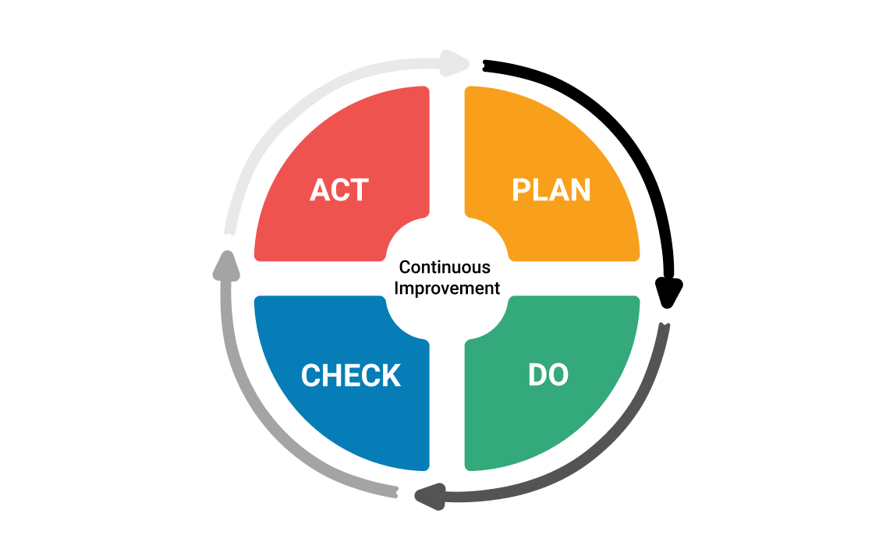
Continuous Improvement

